Slide 1



Pagination
Chapter 27

Slide 2
Today’s Agenda
Using Pagination
What Is Pagination?
How Hibernate Supports Pagination ?
Fetching First Page
Fetching Multiple Pages
Exercises

Slide 3
What Is Pagination ?
If Hibernate fetches large amount of data (records) from the database, it consumes lot of memory.
To reduce this consumption of RAM, the data can be obtained in installments from the database.
And the most popular solution to this is using Pagination

Slide 4
What Is Pagination ?
Pagination is a technique for splitting a list of multiple records into sublists.
For example, you search with a keyword on Google and receive tens of thousands of results.
However, every Google page displays only 10 results for you.
Other results will show on next pages.

Slide 5
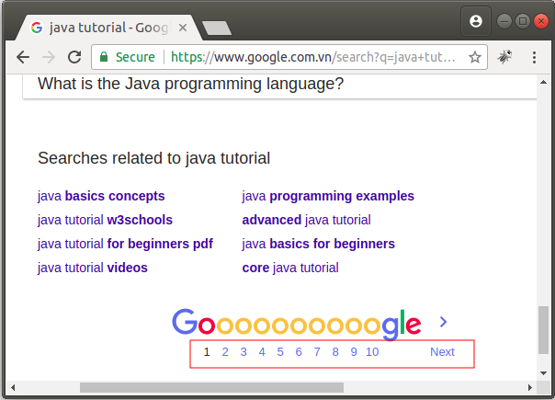
What Is Pagination ?

Slide 6
How To Do Pagination ?
Pagination can be done in the middle tier or in the database itself.
If we are implementing the pagination in the middletier, we have to retrieve all the records from the database and store it in the cache.
It will take more memory and slow down the performance.

Slide 7
How To Do Pagination ?
So, it is good idea to implement in the database.
However, it purely depends on the project requirement.

Slide 8
Hibernate’s Support For Pagination
Hibernate APIs provide few methods to set the pagination criterias in the query.
We can use these methods with , both , HQL and Criteria API.

Slide 9
Hibernate’s Support For Pagination
setFirstResult(int) : sets the starting point of our table record.
setMaxResults(int): sets the maximum result into be fetched from the database in one hit.
Both these methods belong to Query object and is available for
both HQL Query object as well as the Criteria interfaces

Slide 10
Fetching First N Records
Pull first 5 records from employee table
Session sess=sf.openSession();
String hql = "From Employee e ORDER BY e.empNo";
Query qry = sess.createQuery(hql);
qry.setFirstResult(0);
qry.setMaxResults(5);
List empList=qry.list();
Iterator it=empList.iterator();
while(it.hasNext())
{
Employee e=(Employee)it.next();
System.out.println(e);
}
The number 0 here , represents the first record
This says , from first record , fetch 5 records

Slide 11
Retrieving All Records In Pages
Fetch all records in a set of 5 records per page
Session sess=sf.openSession();
String hql = "From Employee e ORDER BY e.empNo";
Query qry = sess.createQuery(hql);
int start=0;
int max=5;

Slide 12
Retrieving All Records In Pages
while(true)
{
qry.setFirstResult(start);
qry.setMaxResults(max);
List empList=qry.list();
if(empList.size()==0)
break;
System.out.println("Page No:"+((start/max)+1));
System.out.println("--------------------------------------");
Iterator it=empList.iterator();
while(it.hasNext()) {
Employee e=(Employee)it.next();
System.out.println(e);
}
start+=max;
}

Slide 13
Pagination Using Criteria
We can use the same setFirstResult() and setMaxResults() methods of the Query object in Criteria API also to apply Pagination.

Slide 14
Fetching First N Records
Pull first 5 records from employee table
CriteriaQuery<Employee>crq=crb.createQuery(Employee.class);
Root<Employee>root=crq.from(Employee.class);
crq.select(root);
crq.orderBy(crb.asc(root.get("empNo")));
Query<Employee>qry=sess.createQuery(crq);
qry.setFirstResult(0);
qry.setMaxResults(5);
List <Employee> ls =qry.getResultList();
Iterator <Employee>it=ls.iterator();
while(it.hasNext())
{
Employee e=it.next();
System.out.println(e);
}

